Slide 1
Project name – 4 Vedas of india
Student name – 14440 – Priyanka Khandagale
14422 – Aishwarya Kadam
DFD & ERD

Slide 2
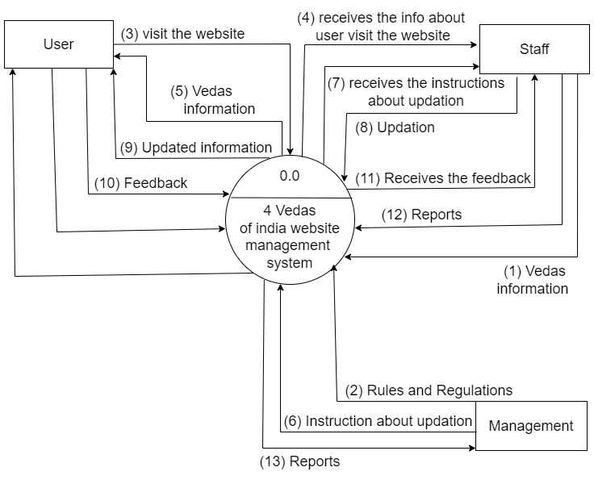
DFD

Slide 3
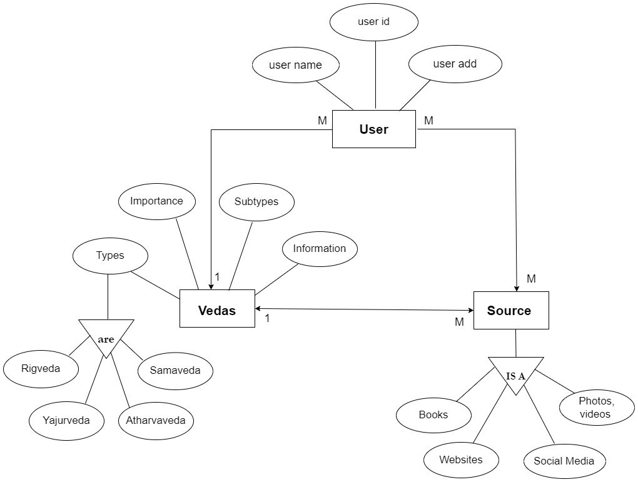
ERD

Slide 4
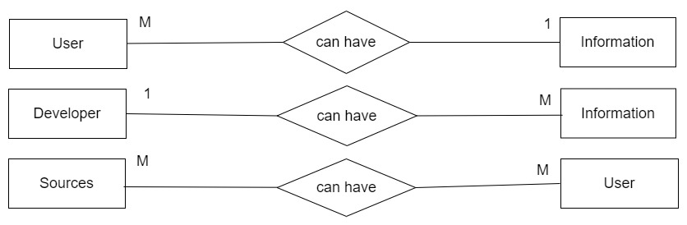
ERD

